Slide 1
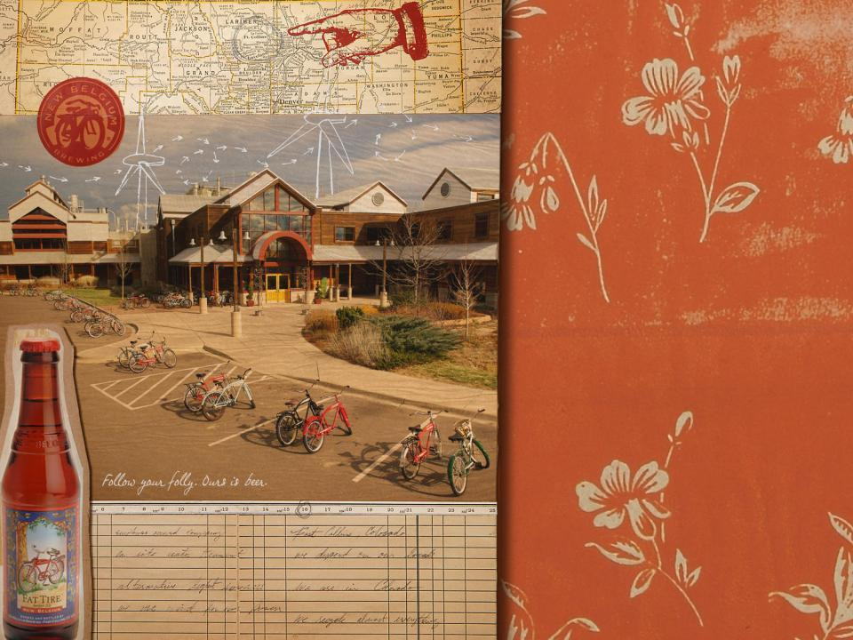
New Belgium
Brewing Company
The Story of our Sustainability
Master Brewers of America Association
25-June-2010
Katie Wallace
Sustainability Specialist

Slide 2
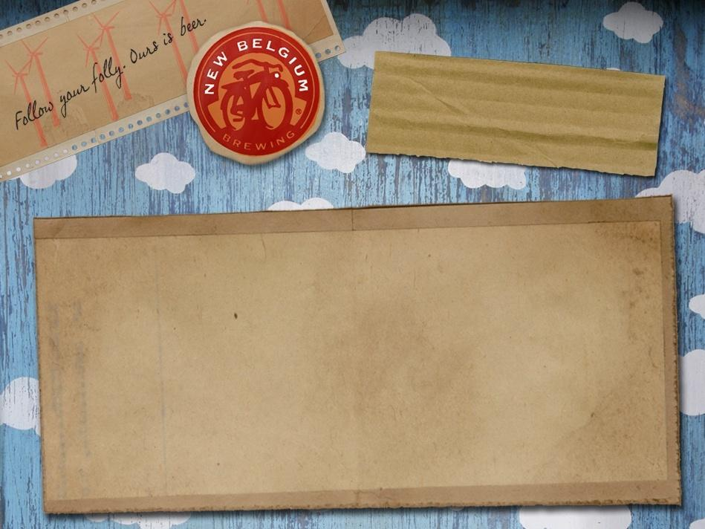
Sustainable Business Role Model
SUSTAINABILITY:
What does this mean?

Slide 3

Humanity living equitably within the means of nature.
Mathis Wackernagel and William Rees (1996)

Slide 4
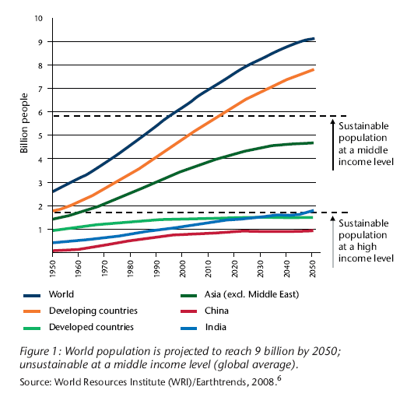

Slide 5

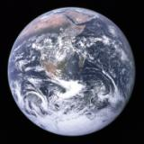
If everybody lived like an American, we would need 5 planets…

Slide 6
Sustainable Business Role Model
WHY?

Slide 7
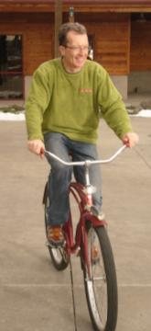
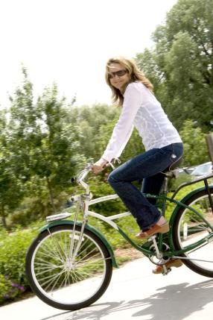
1991
Make world-class beers, focused on Belgian styles
Be environmental stewards
Promote beer culture
Have fun

Slide 8
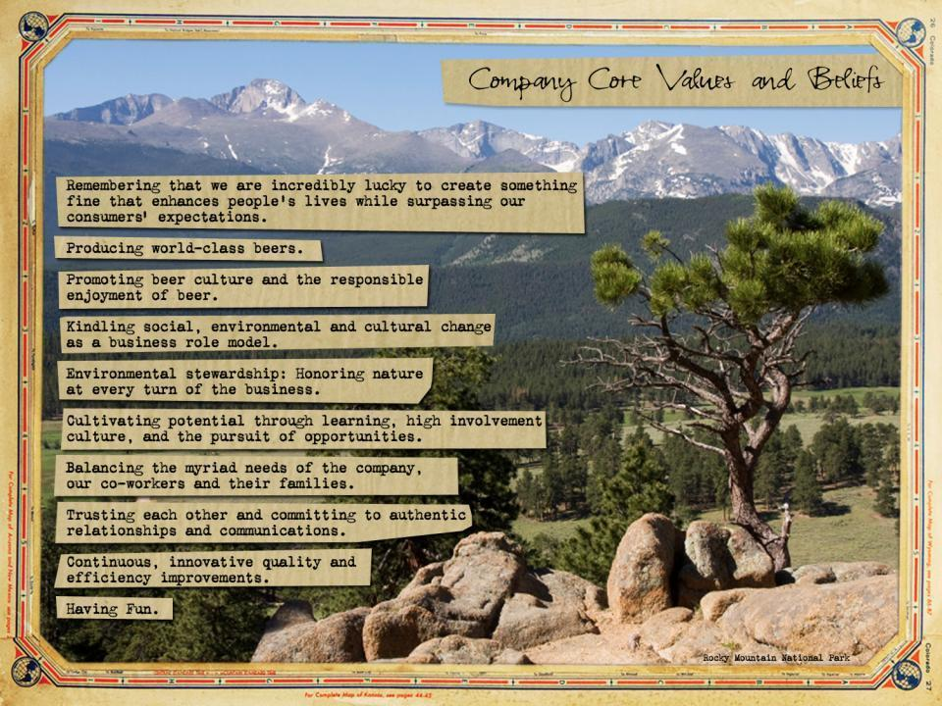

Slide 9
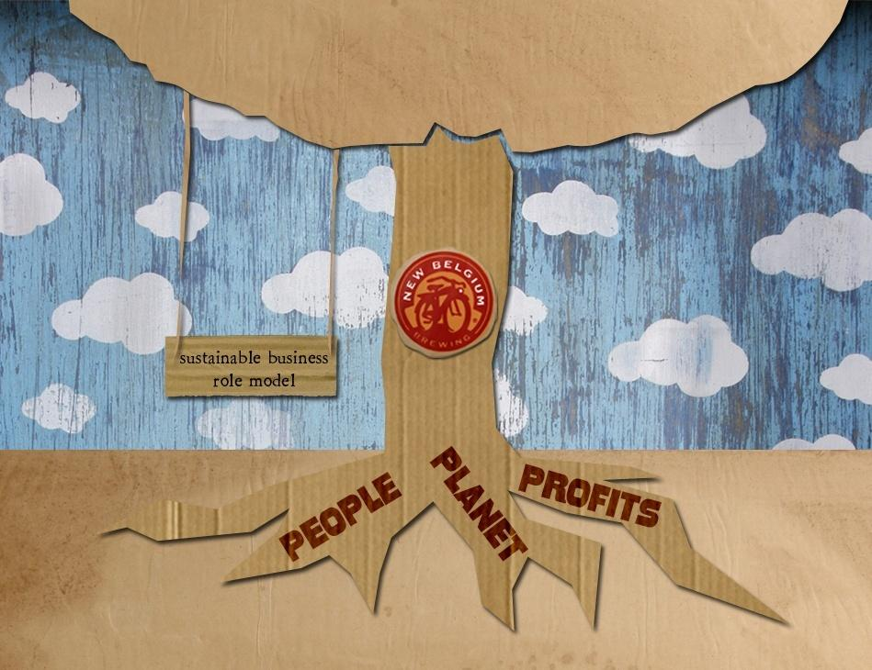

Slide 10

Are we thriving?

Slide 11
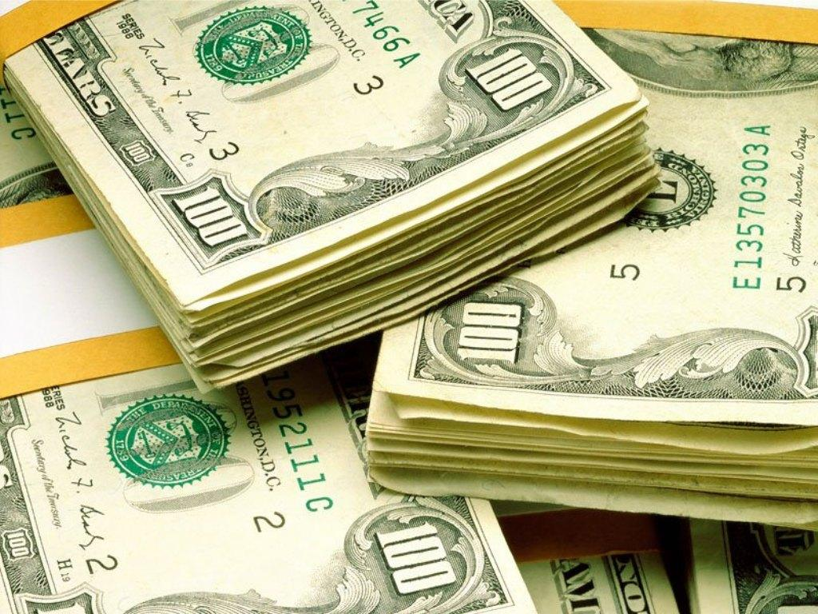
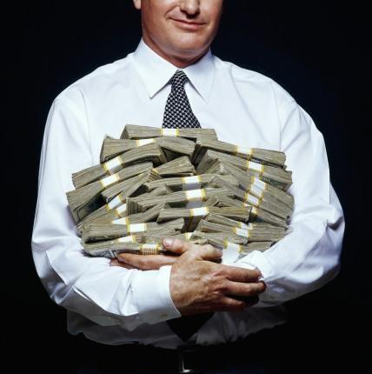

Slide 12
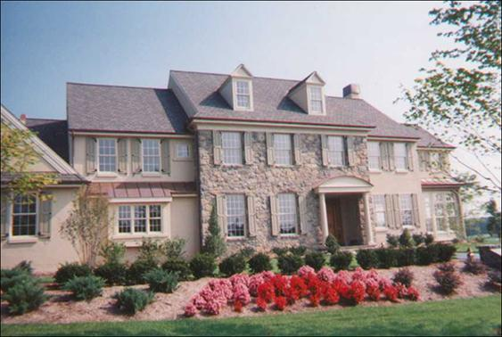

Slide 13
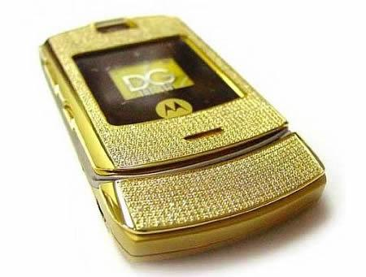

Slide 14
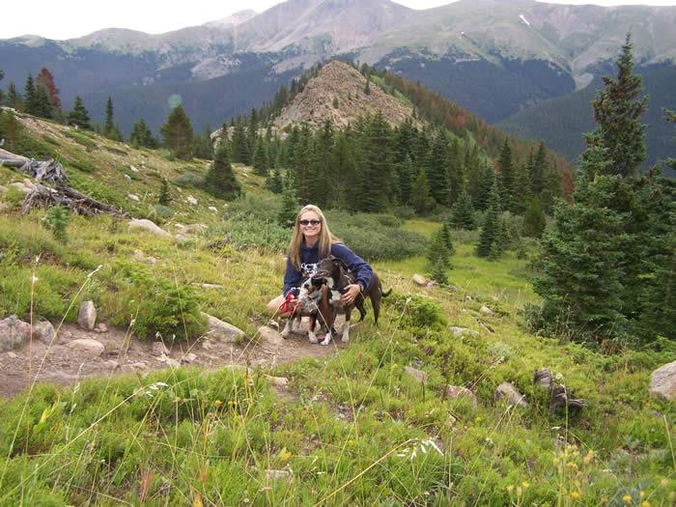

Slide 15
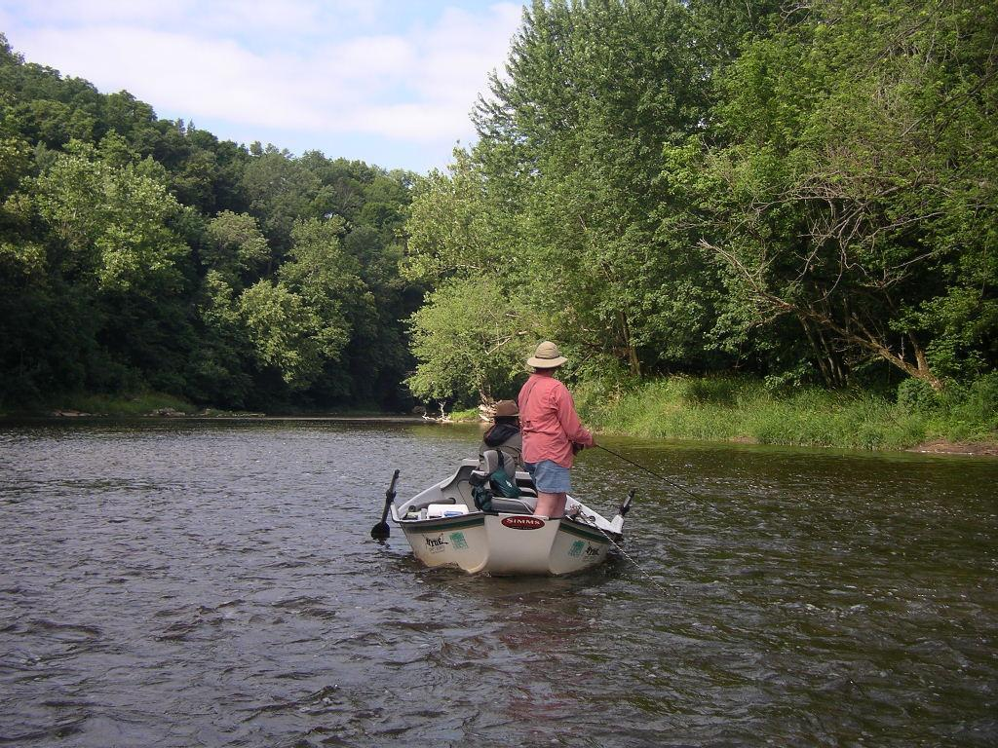

Slide 16
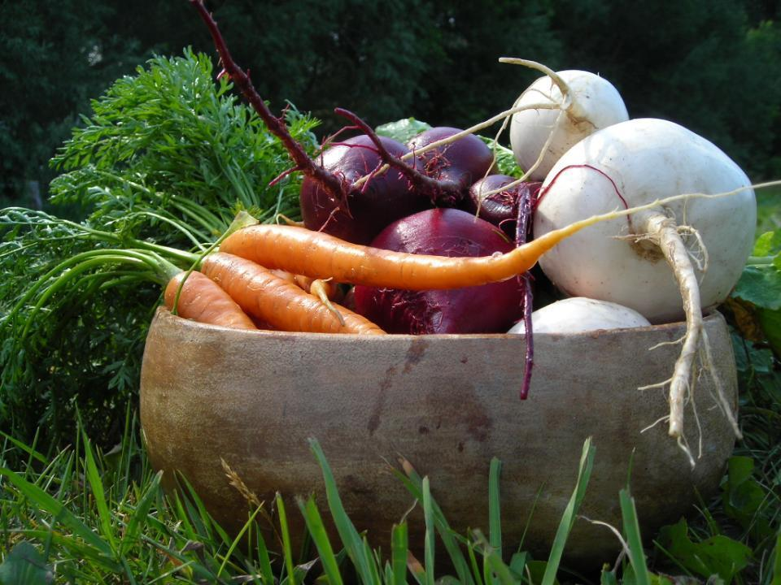

Slide 17
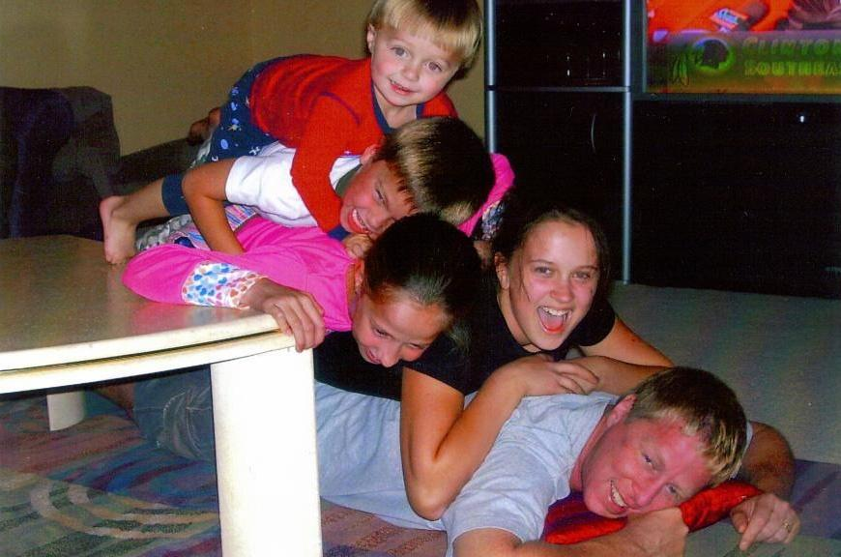

Slide 18
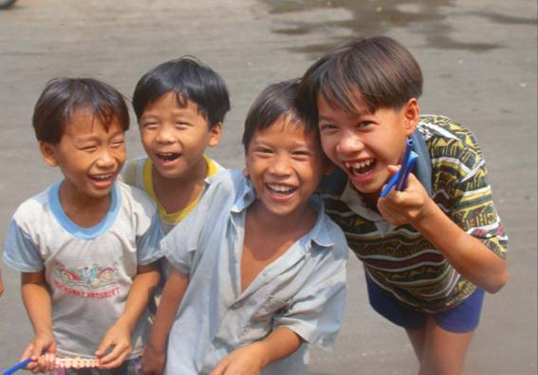
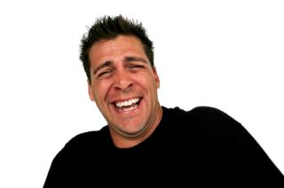


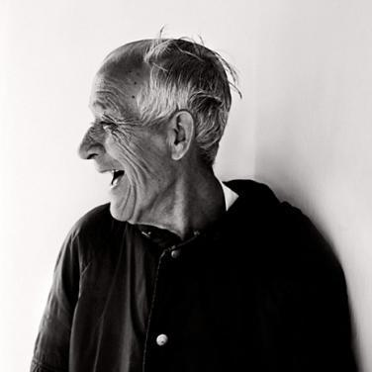
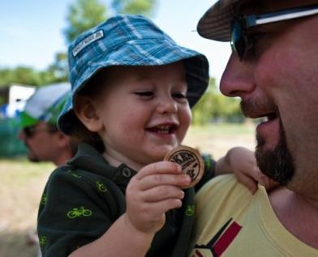
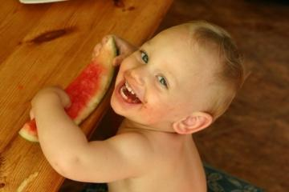

Slide 19
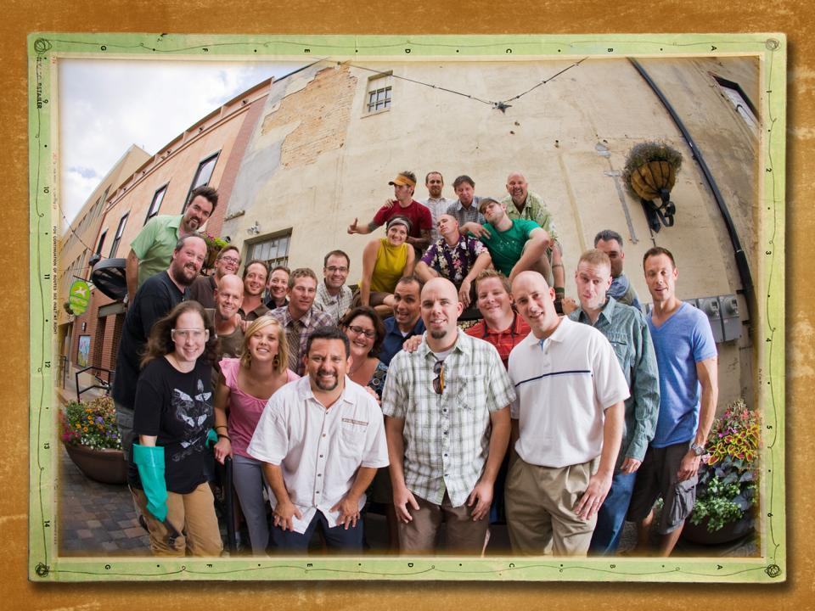

Slide 21
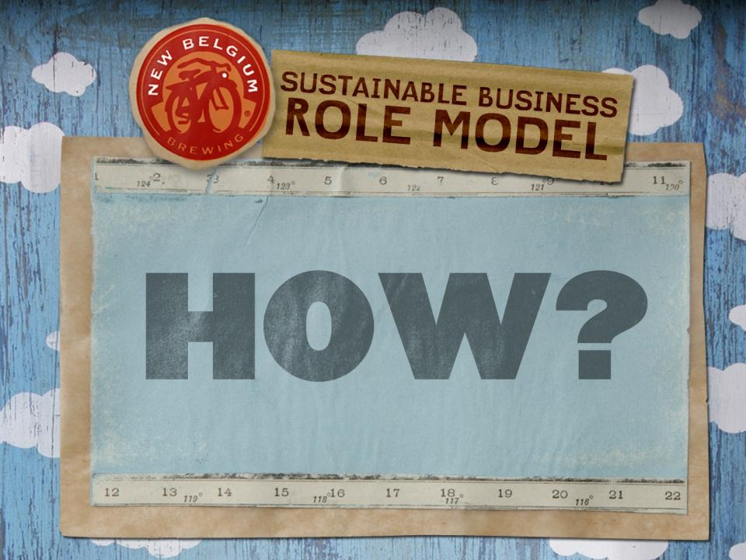

Slide 22
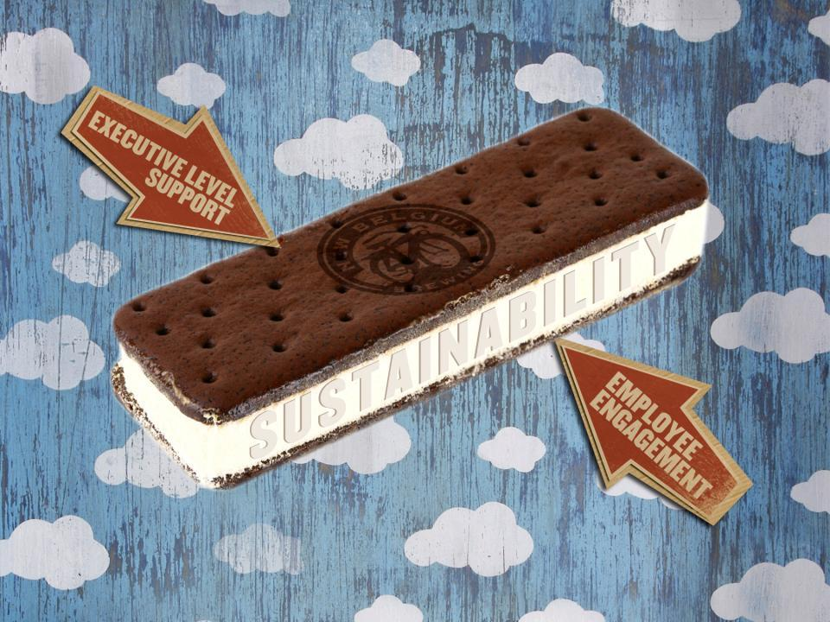
Notes:
At New Belgium we take a top-down , bottom-up approach… otherwise known as the Sandwich Model (one of Lester Brown’s 3 Models for Social Change)

Slide 23


Slide 24
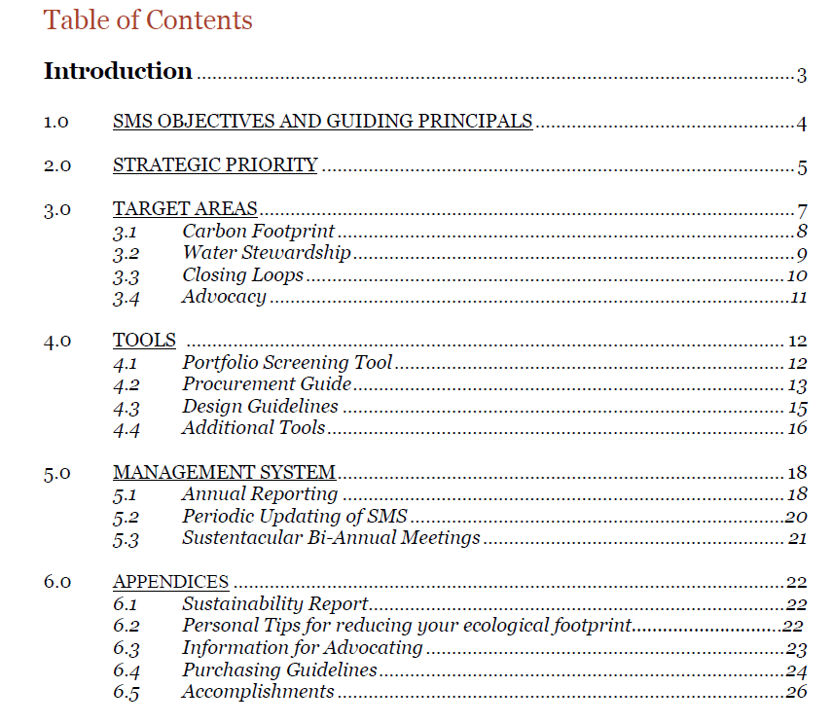
Sustainability Management System (SMS)

Slide 25
Notes:
KATIE

Slide 26
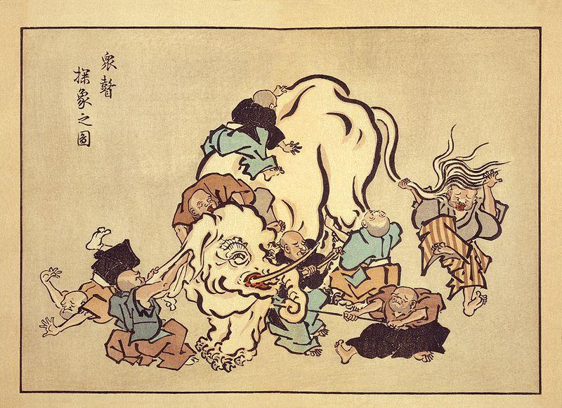
Notes:
Jain version of the story says that six blind men were asked to determine what an elephant looked like by feeling different parts of the elephant's body.
The blind man who feels a leg says the elephant is like a pillar; the one who feels the tail says the elephant is like a rope; the one who feels the trunk says the elephant is like a tree branch; the one who feels the ear says the elephant is like a hand fan; the one who feels the belly says the elephant is like a wall; and the one who feels the tusk says the elephant is like a solid pipe.
A wise man explains to them:
"All of you are right. The reason every one of you is telling it differently is because each one of you touched the different part of the elephant. So, actually the elephant has all the features you mentioned."^{[1]} This resolves the conflict, and is used to illustrate the principle of living in harmony with people who have different belief systems, and that truth can be stated in different ways

Slide 27
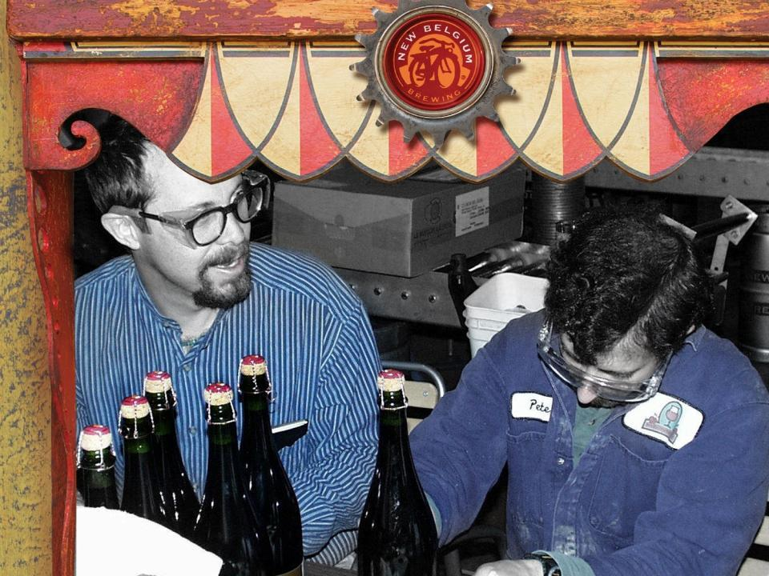

Slide 28

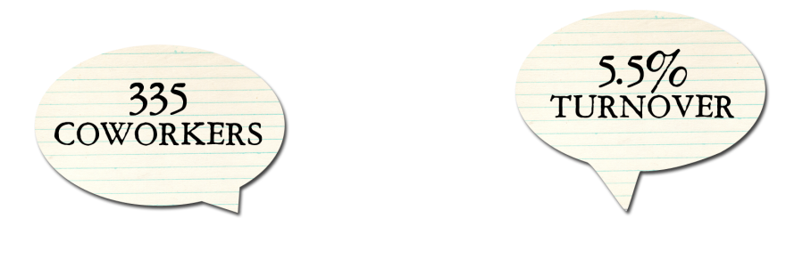
Notes:
Stats from HR as of 31-Dec-2009.
ee’s, 5.5% turnover, employee ownership, profit sharing, OBM
Not making the case the sustainability matters
One of the innovations Kim brings from her background as a social worker is the idea of creating a high involvement culture.
So from the very beginning, we have been an employee-owned company that practices open-book management. Co-workers collectively own 32% of New Belgium through an ESOP program. And we open the books and provide financial training, so people can understand the business of running the business.
There’s good data to show that high performing companies push decision-making and accountability throughout the organization. When you share the risks and rewards of ownership, people have a passion for what they do and love to come to work.
Living up to our values and continuing to forge new ground leads to low turnover, an excellent candidate pool, and how much fun we have.

Slide 29

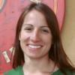
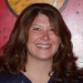
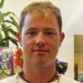
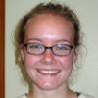
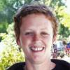

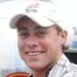
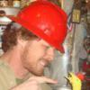
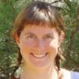


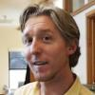
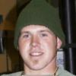
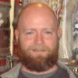
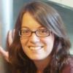


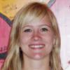

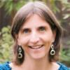
Notes:
KATIE

Slide 30

INreach
Sustainability

Slide 31
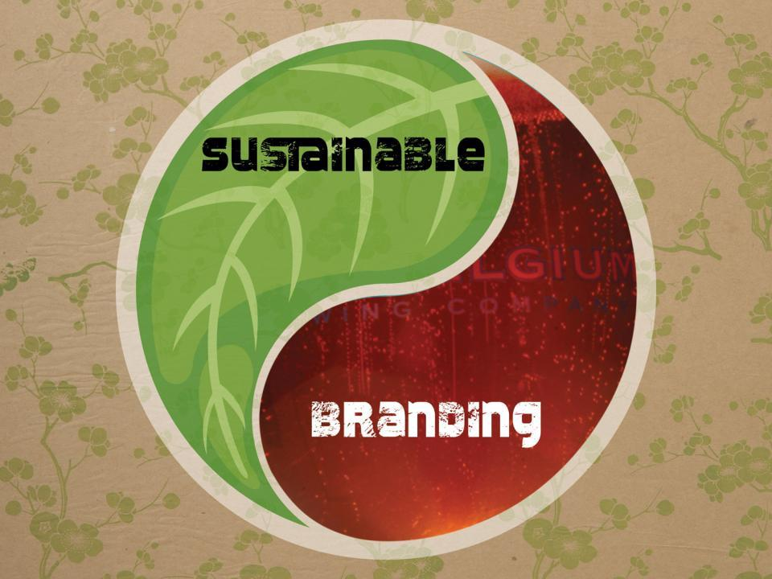
ADVOCACY
ACTION

Slide 32
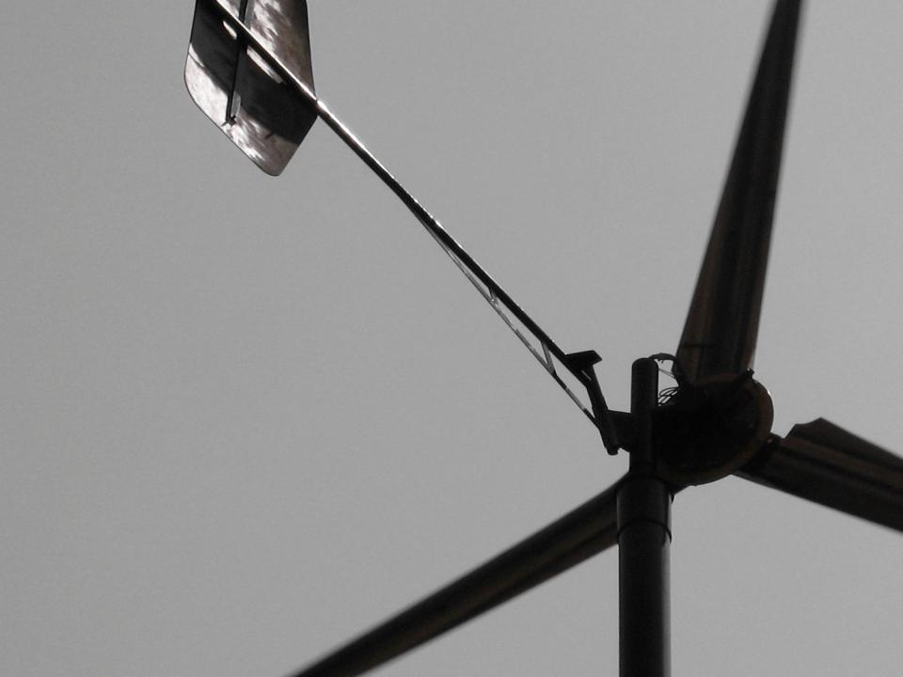
Stewarding our Natural Resources
Water Stewardship
Closing Loops :::: Eliminating Waste
Carbon Footprint :::: Fossil Fuel Consumption

Slide 33
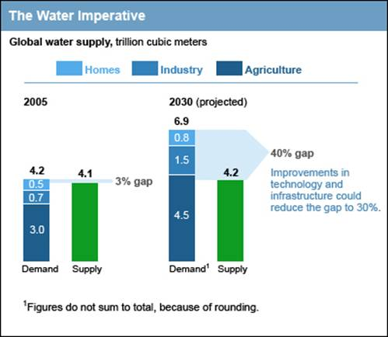
McKinsey & Company, 2009.

Slide 34
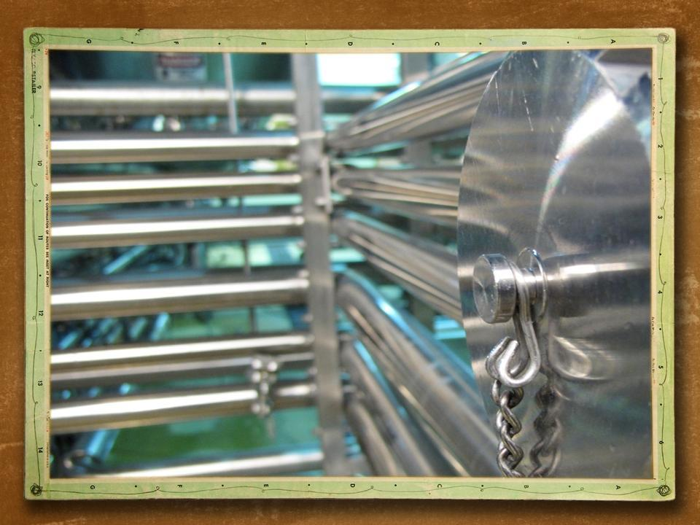
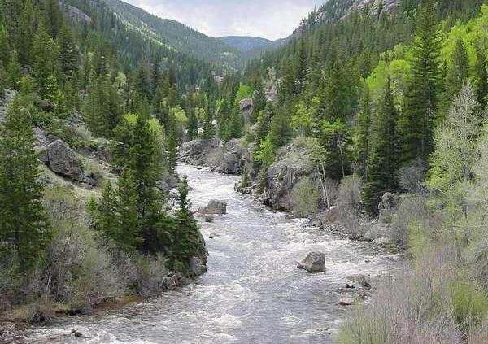

Slide 35
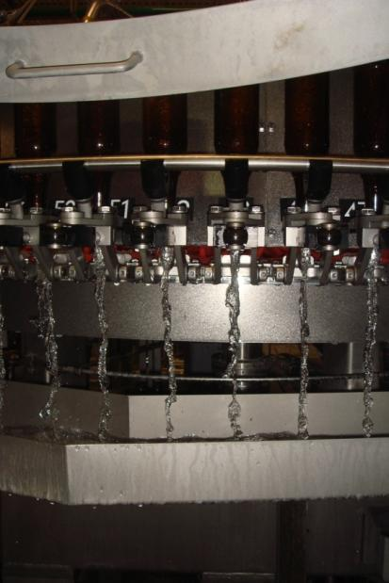
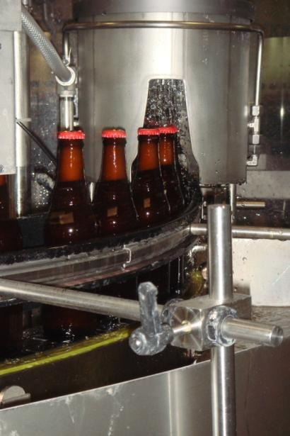
Re-thinking Water Use
ADVOCACY
ACTION

Slide 36
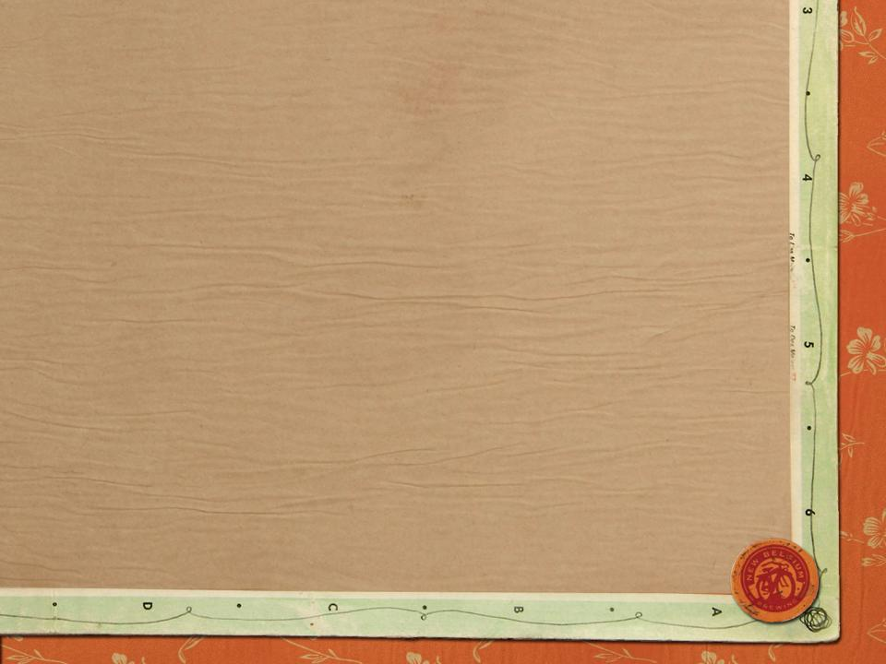




Slide 37


Slide 38
Save the
Colorado
2010

Slide 39

3-year project (2010-2012)
NBB to donate $100,000 each year
To non-profits working to protect the Colorado River and its water supplies
Seeing other corporate (e.g., Patagonia, Aspen Ski Co) and foundation partners to participate also
www.savethecoloradoriver.org

Slide 40


Slide 41

Waste as Resource

Slide 42



Bowling Lane Desk Tops
Carpet roll legs

Slide 43


Slide 44


Slide 45



Slide 46


Brown Bottle Recycling
ADVOCACY
ACTION

Slide 47

Energy Philosophy
REC’s & Offsets
Purchased Green Power
On-Site Power Generation
Energy Conservation
Peak Demand + Total Kwh

Slide 48


Light Shelves
Light Tubes

Slide 49


Slide 50


Glycol lines running under loading dock to melt snow

Slide 51


SMART GRID
Notes:
KATIE
Transport Alexander Graham Bell and Thomas Edison to the beginning of the 21st century to review their technical fields...
Bell would be totally lost and unable to imagine how this technology came from his initial work.
Edison would be right at home and able to understand most all of the grid and how it works.

Slide 52



not-so-SMART GRID
Notes:
KATIE
Traditional grid supplies energy one-way from limited sources. (can compare to one-way street in a relationship – want something more balanced where both have a say)
This system manages only the SUPPLY of energy. If you demand more energy, the power plants will produce it. This is inefficient particularly during peak demand. Power plants then need engines that are only used for a few hours a year.
Bringing varying renewable energy sources like wind, solar and biogas into a system like this (especially from multiple sources) is very challenging.

Slide 53


SMART GRID
A smart grid delivers electricity from suppliers to consumers using digital technology to save energy, reduce cost and increase reliability.
Notes:
KATIE
A smart grid makes renewable energy from multiple sources more efficient and reliable. If it’s dark outside and the wind is blowing, the smart grid knows to pull the wind. It can manage the varying availability of renewable energy sources. It manages the SUPPLY.
But that’s not all! A smart grid allows for two-way communication within the grid, so it also manages the DEMAND. When everyone gets home from work and school, they start using lights, turn on the microwave, the radio, etc. Demand increases. Instead of supplying more energy to meet this peak demand, a smart grid decreases the demand from non-essential energy pulls. For example, at New Belgium, the smart grid can be programmed to know it’s okay to shut off our HVAC or our chillers during that short peak demand.

Slide 54

BIO-GAS from Water Treatment
292 kW
835,000 kWh/yr
10% of total ELECTRICITY

Slide 57
BIO-GAS from Water Treatment
292 kW
835,000 kWh/yr
10% of total ELECTRICITY

Slide 58




Solar array on Packaging Hall
Largest privately owned array in Colorado
200 kW
263,790 kWh/yr
3% of total ELECTRICITY
Notes:
KATIE:
ON-SITE POWER GENERATION: solar

Slide 59



















Slide 60



Slide 61

The Sustainable Purchasing Guidelines
Through action and advocacy, New Belgium strives to be a sustainable business role model, and we prefer vendors who are doing the same. The world is beginning to expect that providers of goods and services be accountable for the impact of sourcing, making, and selling their products. So, not only is sustainable procurement the ethical thing to do, it is strategically advantageous as well. We look to partner with companies who:
    Measure and minimize the environmental footprint of their operations and products by looking at transportation, packaging, waste, energy, toxic substances, water, and CO2 emissions.
    Create a high-involvement corporate culture which values and rewards everyone’s contributions.
    Have a management system which demonstrates environmental commitment by setting goals and regular reporting.
    Are working with others to improve the sustainability of their industry.

Slide 62


Sustainability Management System
Corporate Sustainability Report
Open-book management & financial training for all staff
Quarterly profit-sharing
Cross-functional project selection and prioritization
32% Employee Stock Ownership Plan, 70% employee-owned
Company-wide participation in strategic planning
Non-commissioned sales staff
$1/barrel in philanthropy since 1996 (almost $3 million donated)
1% For the Planet members

Slide 63


Slide 64




Life Cycle Assessment:
Measuring the Carbon Footprint of a 6-pack of Fat Tire

Slide 65
What is a
“Life Cycle Assessment”?
The accounting of
material & energy flows
during each stage of a product’s life
and the assessment of
associated environmental impacts.

Slide 66

What is a
“Carbon Footprint”?
The total amount of GHGs emitted across the life cycle of a product.
The carbon footprint of 1 six-pack of Fat Tire, in 2006, was
3289g CO₂e.

Slide 67
Carbon Footprint for 6pk of Fat Tire = 3,289 grams CO₂e

Slide 68


The Big Picture
2.3%
2.3%

Slide 69

How does Fat Tire Compare?

Slide 70


Slide 71
ADVOCACY
ACTION

Slide 72


Slide 73


Slide 74


Slide 75



